Slide 1

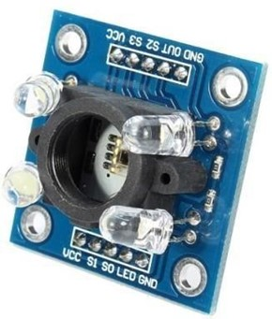
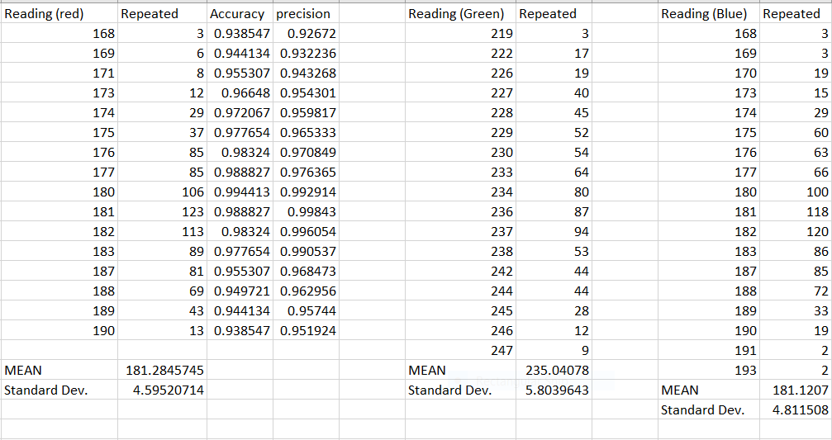
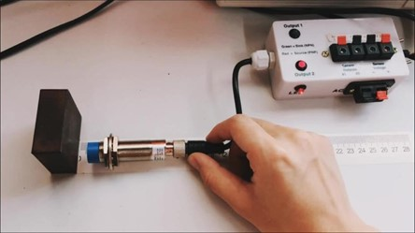
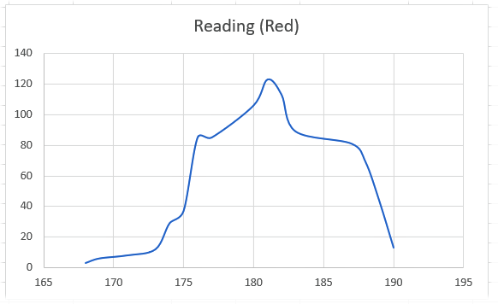
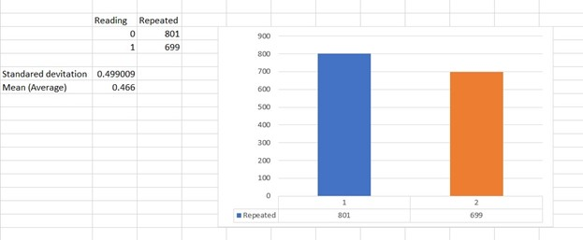
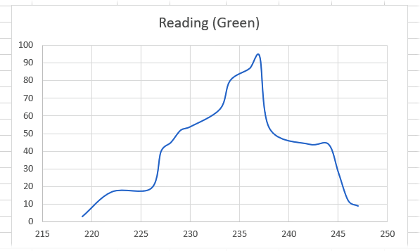
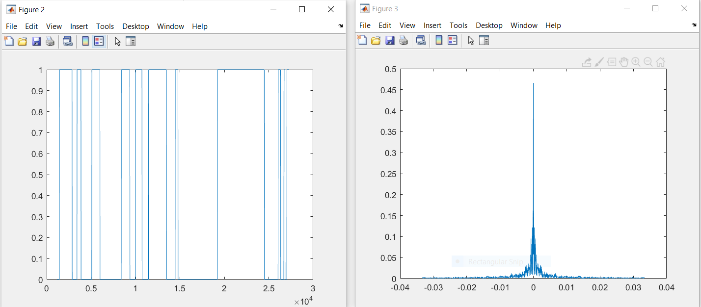
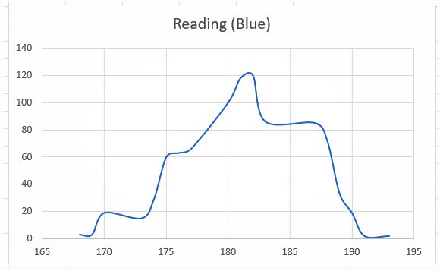
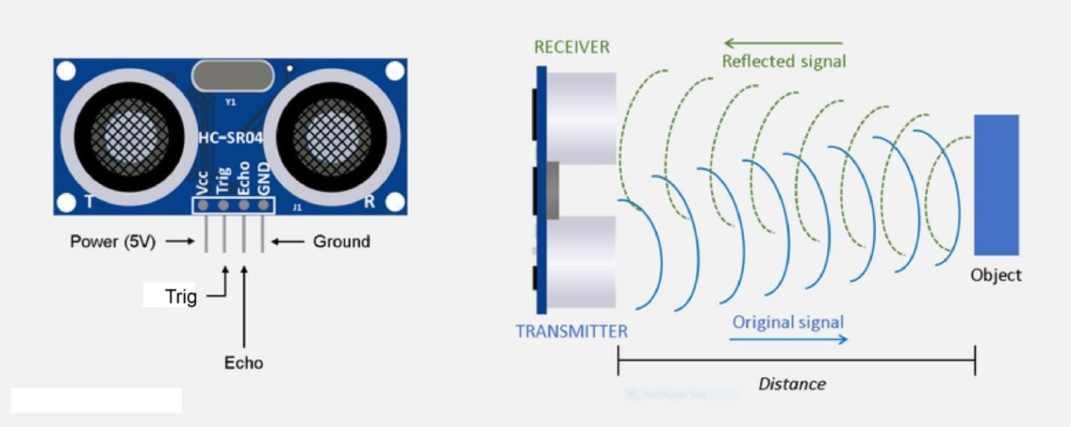
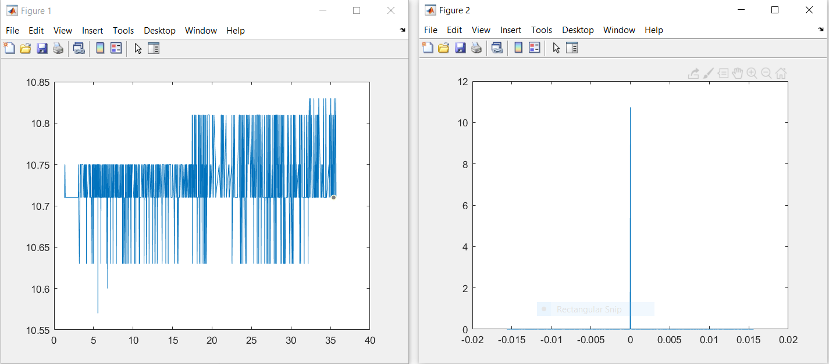
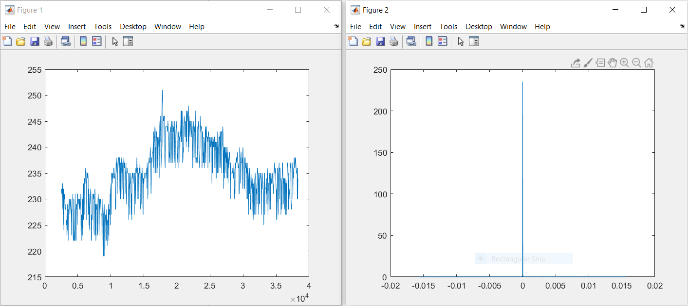
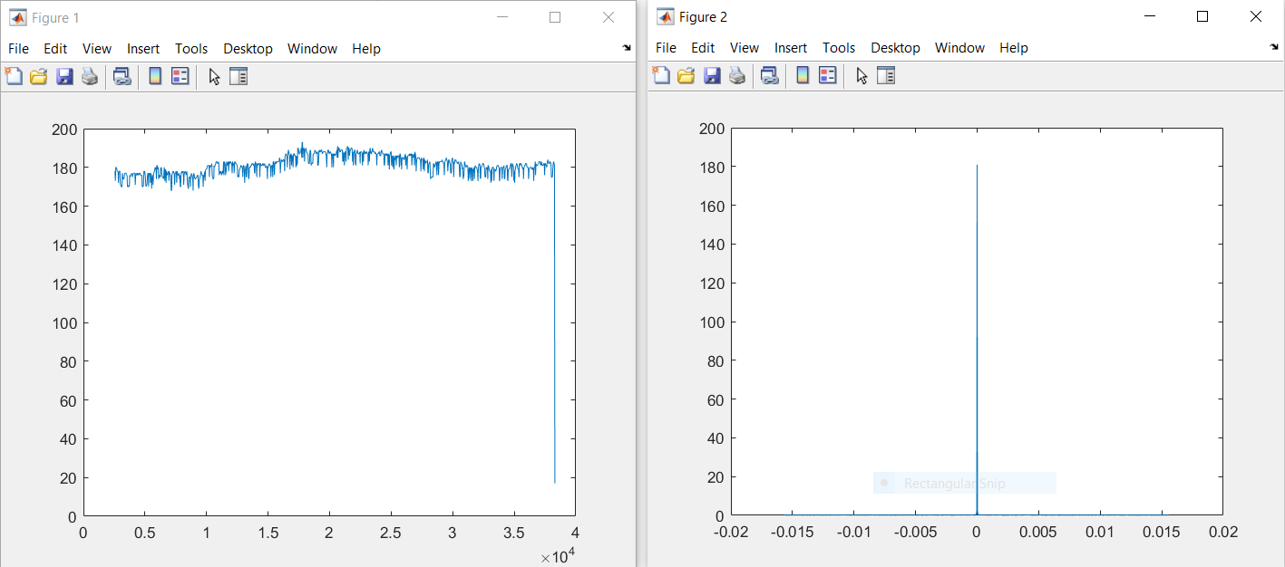
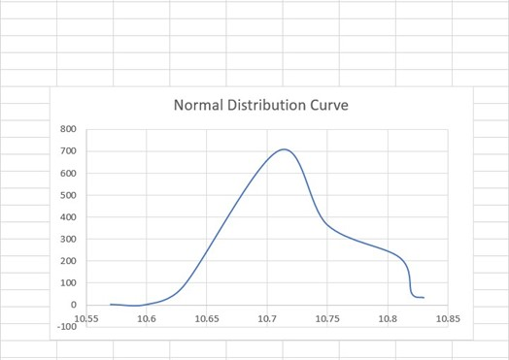
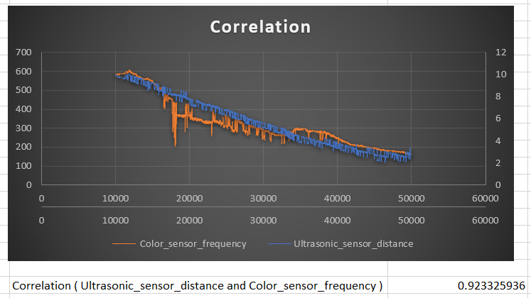
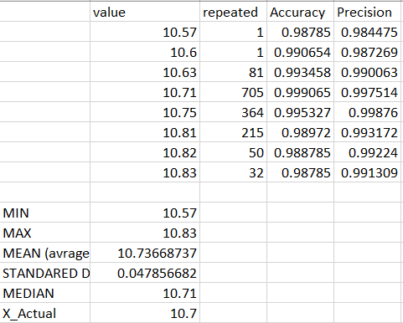
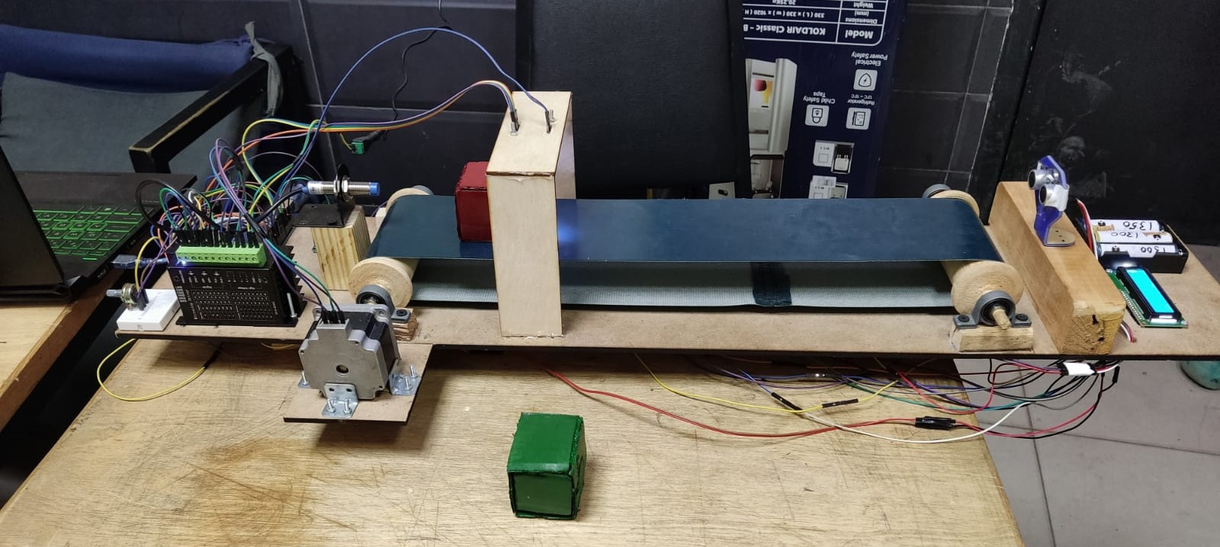
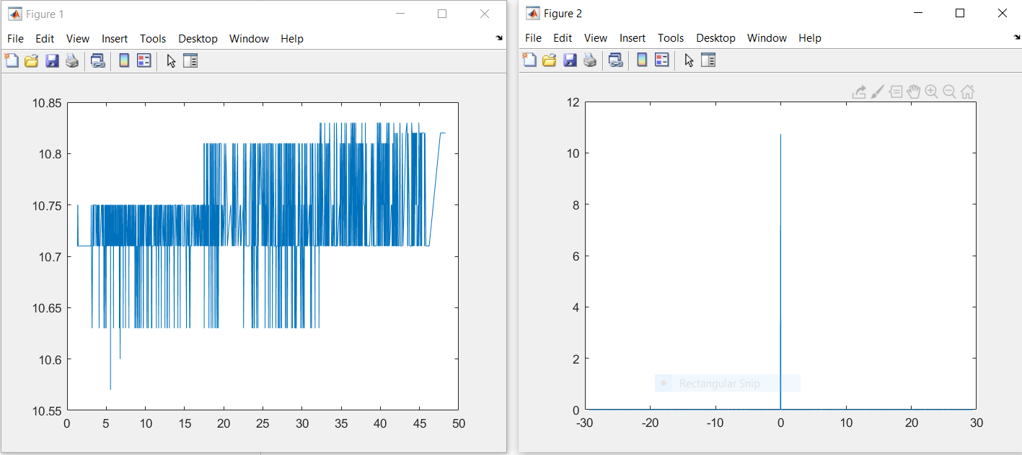





(Industrial Sorting Project)
Introduction
Sorting in industry:
Sorting is any process of arranging items systematically, and has two common, yet distinct meanings:
ordering: arranging items in a sequence ordered by some criterion.
categorizing: grouping items with similar properties.
Ordering items is the combination of categorizing them based on equivalent order and ordering the categories themselves.
Colour Sensor Module( TCS3200):
This Arduino compatible TCS3200 colour sensor module
consist of a TAOS TCS3200 RGB sensor chip and 4 white LEDs.
The main part of the module is the TCS3200 chip which is a
Colour Light to-Frequency Converter. The white LEDs are used
for providing proper lighting for the sensor to detect the object
colour correctly. This chip can sense a wide variety of colours and
it gives the output in the form of corresponding frequency. This
module can be used for making colour sorting robots, test strip
reading, colour matching tests, etc.
The TCS3200 chip consist of an 8 x 8 array of photodiodes.
Each photodiode have either a red, green, or blue filter, or no filter.
The filters of each colour are distributed evenly throughout the
array to eliminate location bias among the colours. Internal circuits
includes an oscillator which produces a square-wave output whose
frequency is proportional to the intensity of the chosen colour.
Common sorting algorithms:
Bubble/Shell sort: Exchange two adjacent elements if they are out of order. Repeat until array is sorted.
Insertion sort: Scan successive elements for an out-of-order item, then insert the item in the proper place.
Selection sort: Find the smallest (or biggest) element in the array, and put it in the proper place. Swap it with the value in the first position. Repeat until array is sorted.
Quick sort: Partition the array into two segments. In the first segment, all elements are less than or equal to the pivot value. In the second segment, all elements are greater than or equal to the pivot value. Finally, sort the two segments recursively.
Merge sort: Divide the list of elements in two parts, sort the two parts individually and then merge it.
The principle of Colour sensor working :
The TCS3200 has an array of photodiodes with 4 different filters. A photodiode is simply a
semiconductor device that converts light into current. The sensor has:
▪ 16 photodiodes with red filter – sensitive to red wavelength
▪ 16 photodiodes with green filter – sensitive to green wavelength
▪ 16 photodiodes with blue filter – sensitive to blue wavelength
▪ 16 photodiodes without filter
If you take a closer look at the TCS3200 chip you can see the different filters.
By selectively choosing the photodiode filter’s readings, you’re able to detect the intensity of the
different colours. The sensor has a current-to-frequency converter that converts the photodiodes’
readings into a square wave with a frequency that is proportional to the light intensity of the
chosen colour. This frequency is then, read by the Arduino – this is shown in the figure.
We will present one level of sorting process using some sensors like:
• Ultrasonic sensor
• Colour sensor
• Inductive sensor
colour_Normal Distribution curve
Inductive Sensor(LM12-2004A):
surveillance of metal elements motion. They can also be used in other machine
systems applications as no contact control sensors for level of liquids, control
sensors for the speed and position of rotating chains, etc. They are developed on
the base of PNP and NPN transition. They have small dimensions and feature a
cylindrical metal shell resistant to vibrations and a plastic lid which is oil and
water resistant.
Electrical Specifications:
• Insulating resistance: ≥ 50 M Ω
• Gearing distance: from 2 mm to 7 mm
• Precision of repetition: 0.01
• Ambient temperature: -25˚С to +65˚С
• Gearing speed: 5mm/s
• Rated voltage: 6~36VDC; 90~230VAC
Features and Specifications:
• Input voltage: (2.7V to 5.5V)
• Interface: Digital TTL
• High-resolution conversion of light intensity to frequency
• Programmable colour and full-scale output frequency
• No need of ADC(Can be directly connected to the digital pins of the
microcontroller)
• Power down feature
• Working temperature: -40oC to 85oC
• Size: 28.4x28.4mm(1.12x1.12")
Normal Distribution curve and analysis
we use during calibration & practical working:
• Fixation of the target at 4,00mm from the capacitive sensor.
• Using relay 5VDC.
The circuit used in the calibration process:
Inductive_Fourier series
Datasheet details that we use during calibration & practical working:
Detecting an object that have Red Colour
Normal Distribution curve
Ultrasonic Ranging Module( HC - SR04 ):
• The basics of using ultrasound are like this: you shoot out a sound, wait to
hear it echo back, and if you have your timing right, you’ll know if anything
is out there and how far away it is. This is called echolocation and it’s how
bats and dolphins find objects in the dark and underwater, though they use
lower frequencies than you can use with your Arduino.
RED_Fourier series
The principle of ultrasonic ranging
GREEN_Fourier series
BLUE_Fourier series
The principle of ultrasonic ranging
sound waves are reflected by obstacles, and the speed
of sound waves is known, so it is only necessary to
know the time difference between transmission and
reception, and the measurement distance can be easily
calculated, combined with transmitter and receiver.
The distance of the device can calculate the actual
distance of the obstacle.
Electrical Specifications
• Operating Voltage: 3.3Vdc ~ 5Vdc
• Quiescent Current: <2mA
• Operating Current: 15mA
• Operating Frequency: 40KHz
• Operating Range & Accuracy: 2cm ~ 400cm ( 1in ~ 13ft) ± 3mm
• Sensitivity: -65dB min
• Sound Pressure: 112dB
• Effective Angle: 15°
Correlation:
Ultrasonic_sensor_distance and Colour_sensor_frequency
Correlation at (distance <= 10 )
Ultasonic_Normal Distribution curve
Components:
Arduino Uno
Ultrasonic Sensor(HC-SR04)
Inductive Proximity Sensor(LM12-2004A)
Colour Sensor
Stepper Motor(Nema 23)
Nema 23 Driver
Flexible Coupling
Conveyor Belt
LCD Screen
2 Battery (12 v)
Wood Plates
Relay one channel
Jumpers
Datasheet details that we use during calibration & practical
working:
• Fixation of the target at 10.7 cm from the ultrasonic.
Ultasonic_Accuracy & precision & analysis
System of the project
Reference : Alan S. Morris. (2011). Measurement and Instrumentation
Theory and Application(second edition),
Ams Datasheet TCS3200,TCS3210
Elec Freaks Datasheet HC-SR04
Ital-sensor Datasheet LM12-2004A
Ultrasonic_Fourier series
Sensors & Measurement Systems (MCT-334)
Anas Ahmed Talaat
1806766@eng.asu.edu.eg
Mohamed Emad Mohamed
1806770@eng.asu.edu.eg
Elsayed Ayman Elsayed Habib
1804765@eng.asu.edu.eg

